Slide 1

HANA Memory Sizing Estimations
Aditya Mallavarapu

Slide 2

Why

Slide 3

Without HANA Estimations
Custom code again!!!
Performance issue??
Why is the Column Store occupying all Memory??
Emergency Scaling
Unplanned Downtime
Budget deviation
HANA Out-Of-Memory !!!!!!

Slide 4

Which Options exist??
Quick Sizer??
T-Shirt rules?
Combined Approach
ABAP Sizing report??
Assumptions may change
For Short Term planning

Slide 5
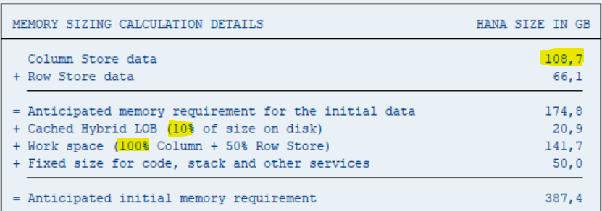
Possible Limitations
Static Assumptions & simplified Data growth
Data Tiering effects are not considered
Based on SAP Standard scenarios
Quick Sizer
Focuses on Disk based Projections with default Working Memory assumptions (100% of Column Store footprint)
ABAP Sizing reports

Slide 6
How to Optimize

Slide 7
Sizing Analysis – Iterative Approach
Analyze Data Footprint
Workload Optimization
Housekeeping
Working Memory Requirements
Data Archiving
Data Tiering(NSE)

Slide 8
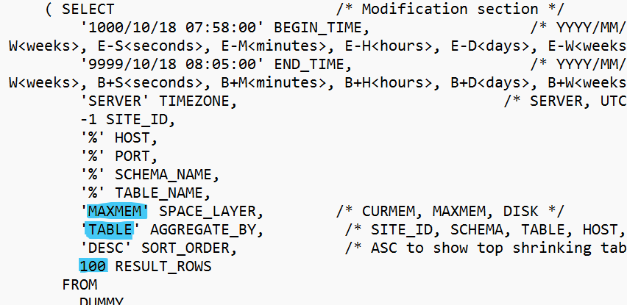
Analyze Data Footprint - Inflow
SQL Statement Script – HANA_Tables_LargestTables_2.00.040+ SAP Note 1969700

Slide 9
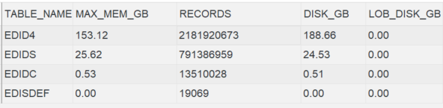
Analyze Data Footprint - Inflow
SQL Statement Script – HANA_Tables_LargestTables_2.00.040+ SAP Note 1969700
Sample Output
Max_Memory_size = Disk_Size – LOB_Disk_Size
Record Size = Max_Mem_Size/No of Records

Slide 10
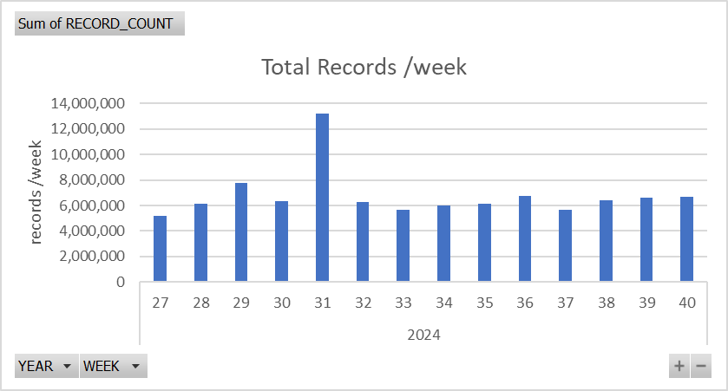
Data Inflow – EDID4 Example
Memory Size of each Record
No. of Records per Week - TAANA T-Code (Table Analysis)
Record Size = ~93 Bytes
No. of Records/ Week = ~6 million
Data Inflow Memory Estimation/Quarter
=
(Memory Size per Record ) * (No. of Records per Week) * 12 Weeks = ~6.2 GB

Slide 11
Data Outflow - Archiving & Housekeeping
Residence Periods
Records that are older the residence periods , qualify for Archiving/Housekeeping
Archiving may not delete all qualified records due to dependent Open Transactions as an example.
Success rate
Records actually reduced in a Specific Period (Week)
Deletion / Housekeeping Jobs Spool provides the Actual records reduced
Accrued Data = Total Records – Actual Records Reduced
Data Outflow Memory Estimation /Quarter
=
(Memory Size per Record ) * (Actual Records Reduced/Week) * 12 Weeks

Slide 12
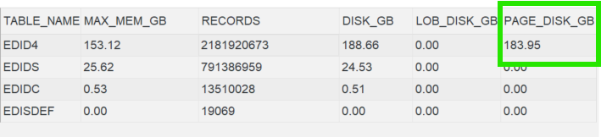
Data Tiering – EDID4 Example
NSE Saving Factor - EDID4
Paged out data : ~97 % of Data Footprint is saved
NSE applied for the Whole table
~3 % of Data Footprint in Memory ( after NSE)

Slide 13
Estimated Data Footprint
Data Inflow
/Quarter
Data Outflow
/Quarter
Accrued Data
Estimated Data Footprint
Data Footprint Estimation with NSE
=
Estimated Data Footprint * (% of Data Footprint after NSE/100)

Slide 14
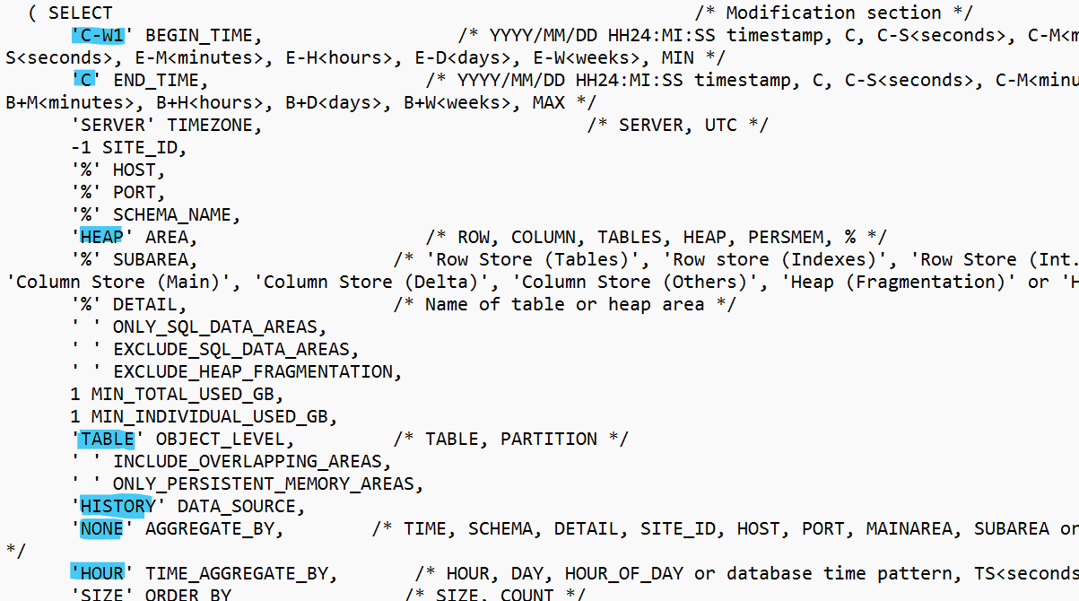
Working Memory - Trend Analysis
SQL Statement Script – HANA_Memory_TopConsumers_2.00.060+ - SAP Note 1969700

Slide 15
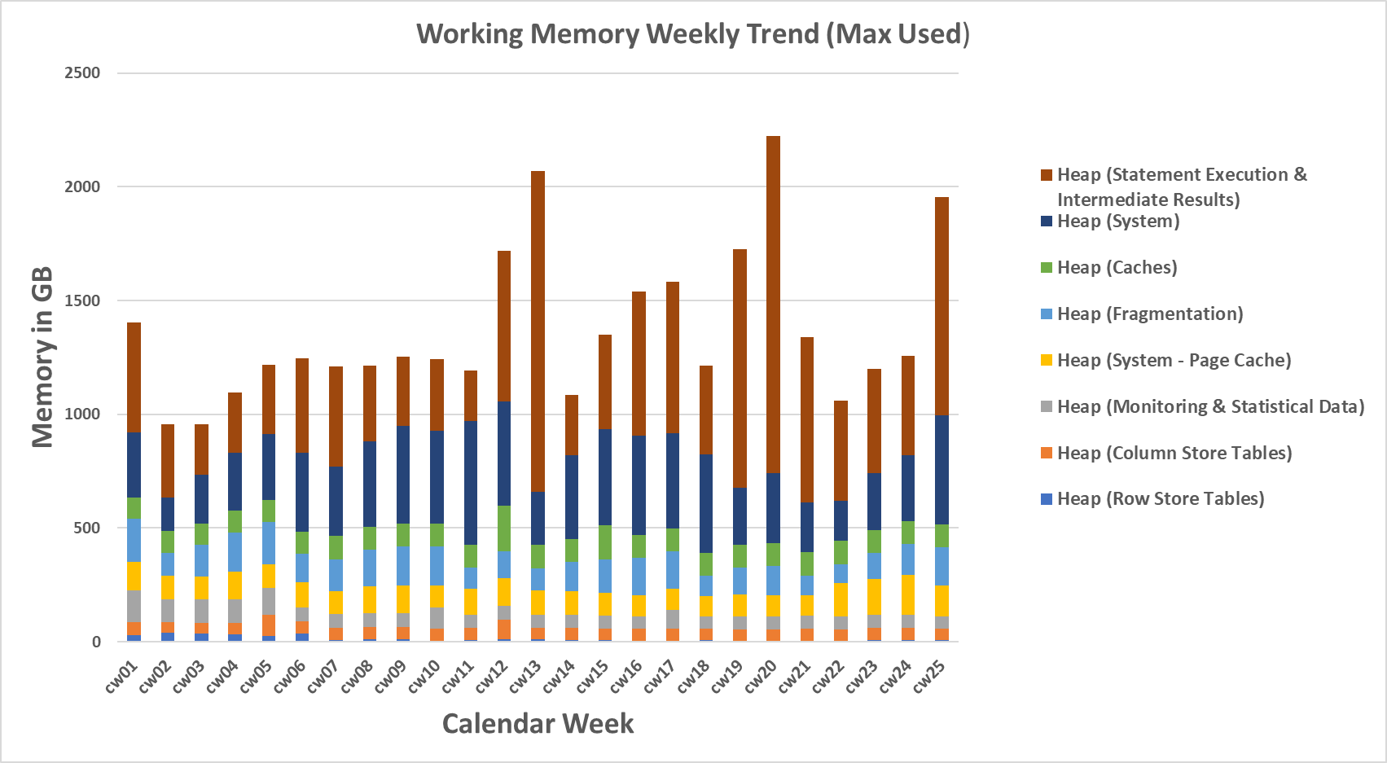
Working Memory - Trend Analysis

Slide 16

Optimization - Workload Management
Short Term Actions
Apply Global Workload limits
Monitor Expensive Statements
Long Term Actions
(with S/4HANA examples)
Optimize Problematic SQL Statements
Check Custom Codes operating on Tables redirecting to Compatibility views
Default Individual Statement Memory Limits
Default Concurrency Thread Limits
Total Statements Memory Limit
Define Individual Workload Classes , if necessary
Reference SAP Note 2222250
Reference SAP Note 2000002
For Ex: Select Query on MARC redirects to an expensive CDS view NSDM_V_MARC
Alternate lightweight views are available such as V_MARC_MD, if the program requires only Master data attributes

Slide 17
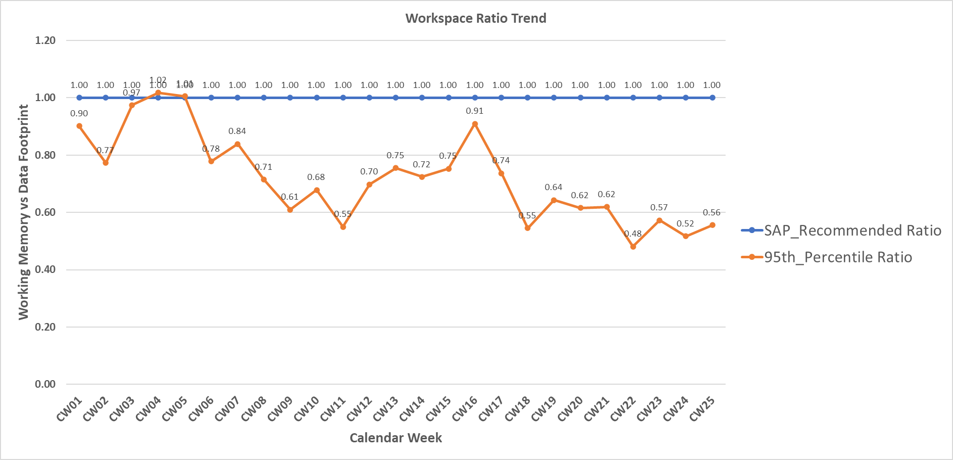
Workspace Ratio
Workspace ratio is Working Memory / Data Footprint in Memory
SAP recommends to have 1:1 Ratio
95 Percentile – 95 out of 100 occurrences
Working Memory
= Estimated Data footprint with NSE* (Avg of 12 weeks Workspace Ratio)

Slide 18
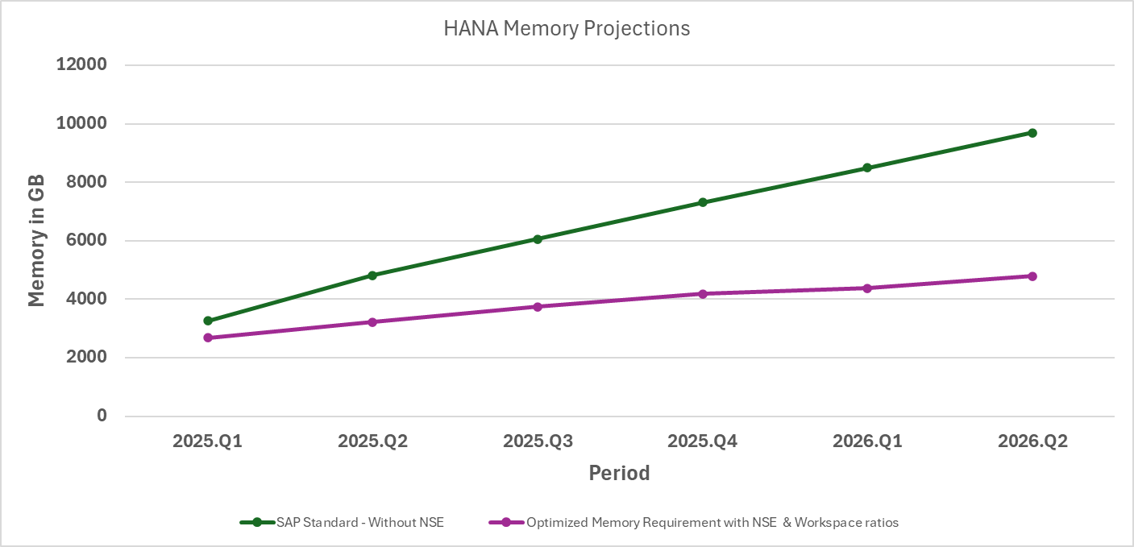
Memory Estimations

Slide 19


With Proper Estimations
Scalability is understood
I know my HANA Estimations & Hardware is ready
Architecture is Sufficient
Performance is under control
Efficient Budget Planning

Slide 20
Key Takeaways
HANA Sizing Analysis is not a Silos activity ☺
Working Memory is a moving Target and should be regularly monitored & controlled via WLM
Analysis should be repeated for any Major changes to SAP System
Review the Inflow & Outflow patterns & Data tiering Saving factors as necessary
Continue to explore options to reduce the Memory footprints

Slide 21


Questions
Aditya Mallavarapu
www.linkedin.com/in/aspk-mallavarapu
phani.mallavarapu@gmail.com

